Slide 1

Proposed Budget Presentation
Fiscal Year 2023 / 2024

Slide 2
Fiscal Year 2023-24 effective July 1, 2023
General Fund: $1,450,350
For services like residential garbage collection, public safety, and recreation facilities.
*Revenue primarily from property and other taxes.
Water & Sewer Fund: $794,195
For water and sewer service, including system maintenance and improvements.
*Revenue primarily from utility charges.
Rates and Fees
No Change to property tax rate of 39 cents per $100 of assessed value.
Increase to water and sewer rates of 2% each.

Slide 3
Breakout of General Fund Revenues
Total Estimated General Fund Revenues $1,450,350.
__________________________________________
Property Tax Revenues account for 47% of the General Fund budget and are estimated at $678K.
Real property values increased by 62% with the 2023 revaluation, however industrial and commercial personal property valuation has declined 31% over the last 3 years, reducing the total taxable value by $13 million dollars.
Sales Tax and Utility Franchise revenues are expected to remain consistent at $200K and $270K respectively.
Restricted funding makes up 13% of revenues in Powell Bill allocations and grant awards.
General Fund & Powell Bill reserves in the amount of $79,850 were necessary to balance the budget.

Slide 4
Property Valuation & Tax Rate
This year's budget proposed no change to the property tax rate of .39 cents per $100 of assessed value.
Gaston County approved a revenue neutral tax rate of .61 cents per $100 of assessed valuation to reduce the financial impact to the average citizen.
McAdenville has a small tax base valuation. For this reason, 1 penny on the tax rate produces only $17,000 in revenue. For comparison, 1 penny produces $1 million dollars in revenue for the City of Gastonia.
The real property revaluation conducted by Gaston County increased the taxable value of real property in McAdenville to $152,169,662 from $94,193,591.
McAdenville’s municipal tax rate will remain the lowest in Gaston County.

Slide 5
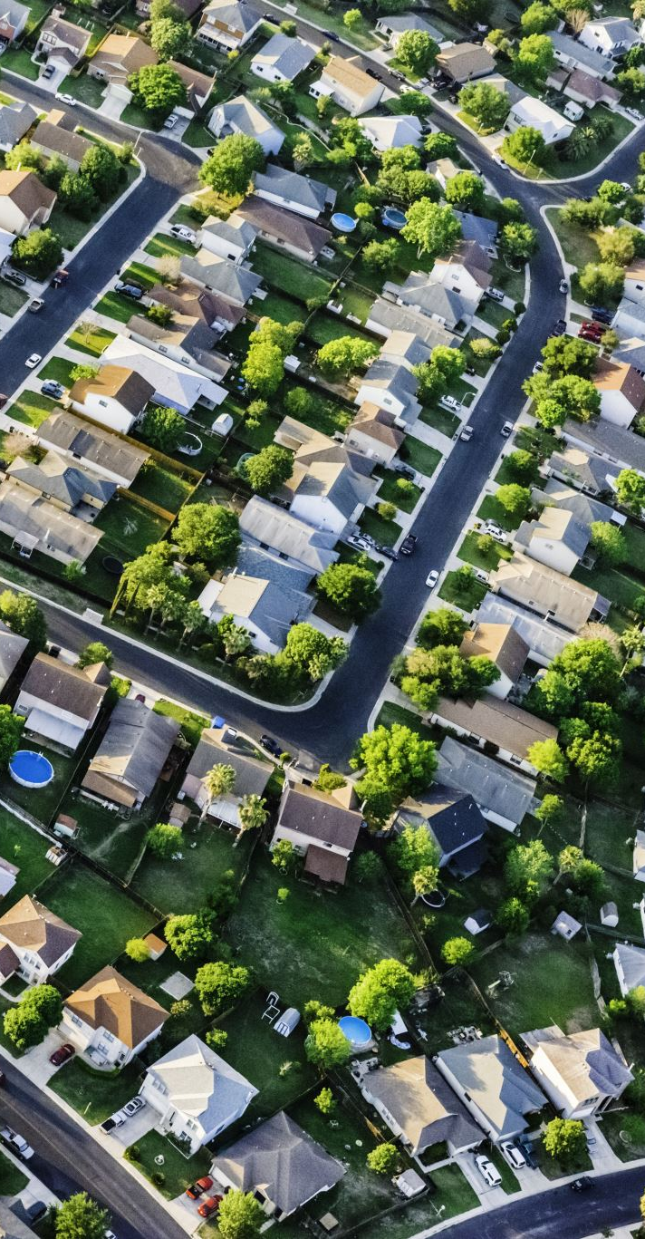
How will the Revaluation impact my tax bill?
Previous Home Value Avg Value Increase Estimated Tax Increase
$150,000 $243,000 $ 363.00 / year
$200,000 $324,000 $ 484.00 / year
$300,000 $486,000 $ 725.00 / year
$400,000 $648,000 $ 967.20 / year
$500,000 $810,000 $1,209.00 / year
Calculations are based on the average real property value increase of 62%.

Slide 6
Overview of General Fund Expenses
Increases in General Fund expenditures have been impacted in the following departments: Salary & Benefits, Police & Fire, Parks & Recreation, Public Works, and Capital Expenditures.
Service levels will remain the same for police, fire, and waste/recycling collection in FY2024.
Police & Fire protection remain the largest expenditures in the General Fund Budget. The cost of contract services for these items has increased 20% since 2019.
Two new staff positions will be funded in the upcoming budget including a full-time finance officer, and part-time clerical position.
Major shift in this year’s budget is a 54% increase in funding for Capital improvement Projects. Many projects placed on hold during the pandemic have been reprioritized and funded in FY2024.

Slide 7

Planned Capital Improvement Projects for FY2023-24
McAdenville Greenway Park
Picnic shelter
Monument and directional signage
River Link Greenway
Design plans are 60% complete
CTT grant award received for $150K
2023 focus is securing additional grant funding for construction. Estimated construction cost will be $1 million.
Refurbish Town Assets
Upfit of lower level of Town Hall to accommodate expanded staff.
Interior improvements to Fire Station.

Slide 8

Water & Sewer Fund
W&S revenues are estimated to be $794,195 for FY2023-24. (down $82K from FY2023)
Fund Balance reserves in the amount of $161,445 were needed to balance the budget.
Increase of 2% in water/sewer rates effective 7/1/2023.
  Monthly minimum bill (2500 gal) $54.47 – Increase of $12.84/year
  Monthly minimum bill (5000 gal) $99.25 – Increase of $24.00/year
Approved CIP for water/sewer projects totals approximately $17 million dollars
In July of 2020, the Viable Utility Reserve (VUR) program was established by the State Water Infrastructure Authority and the Local Government Commission to provide aid to at risk and distressed utilities in NC. McAdenville qualified for the state VUR program in 2022 which provided opportunities for up to $15 million in grant funding for approved CIP projects.
McAdenville submitted four applications in 2022 to DWI for various water & sewer projects. To date, two applications have been approved and awarded grant funding totaling just over $7 million dollars.
A system merger with the City of Gastonia/Two Rivers Utilities is still being evaluated.

Slide 9
Water/Sewer
Capital
Improvement
Projects
Sewer Collection
Pharr Line - Northern Section (4)
Pharr Line - Southern Section (4) |  |  |  |  |  | $ 4,926,617.00
Poplar Street & Aviary Court (4)
Water Distribution
McAdenville System - PRV Replacement (1) |  |  |  |  |  | $ 250,000.00
Mockingbird Line - Abandon 2" & reconnect customers (5) |  |  |  |  |  | $ 125,000.00
Correct Cross-Connetion at Industrial Facilities (2)
Wesleyan Drive Interconnect (2) |  |  |  |  |  | $ 3,749,048.00
Ford Drive & Oak Drive - Line Replacement (3)
Poplar Street & Aviary Court - Line Replacement (3) |  |  |  |  |  | $ 3,269,750.00
Pine Street & Fir Street - Line Replacement (3)
Main Street - New Extension (4)
Hickory Grove Road - Line Replacement/Upsize (4) |  |  |  |  |  | $ 4,581,639.00
Riverside Drive & Rankin Road - Loop System (4)
 |  |  |  |  | Total: ** | $ 16,902,054.00
(1) - Funded by W/S fund balance / Currently in Design
(2) - Grant Funded - Engineering Rpt in progress
(3) - Grant Funded - Awaiting award notice from DWI
(4) - Projects being evaluated for future grant applications
(5) - Project moved to FY2025 - Funded by W/S fund balance
** Estimated cost and subject to change

Slide 10

Questions & Comments

